Slide 1
Providing Support to the Introduction of
CAV Impacts into Regional Transportation Planning and Modeling Tools
NCHRP 20-102(09)
June 30, 2018
Notes:
The NCHRP 20-102(9) report presents guidance related to modeling and forecasting tool updates for planners and modelers in state departments of transportation (DOTs) and regional metropolitan planning organizations (MPOs) to more appropriately account for the impacts of connected and automated vehicles (CAVs) on transportation supply, road capacity, and travel demand components. The authors acknowledge that considerations in the CAV space are changing rapidly and that this report may need updating in the next three to five years.

Slide 2
Disruption is upon us. As a planner or modeler, how should you respond?
Forecasting Travel Behavior in the Context of CAVs
Definitions of AVs and CVs
Framework for Planning and Modeling CAVs
Planning Context
Modeling Systems
Communicating Under Uncertainty
Conclusions
Notes:
Planners and modelers are concerned with long-range forecasting of travel and related consequences in urban regions. Forecasting the impacts of CAVs on transportation systems is challenging. Since long-range forecasts are made for 20 to 30 years into the future, planners can expect that this system of technologies will, by that future time, have significant impacts on the transportation system and travel choices. This report describes the challenges of forecasting travel behavior in the context of CAVs, defines AVs and CVs, provides a framework for planning and modeling CAVs, discussing addressing uncertainty in the planning context, describes needed updates to three different modeling systems (trip-based, activity-based or dynamic, and strategic models, and presents best practices for communicating under uncertainty.

Slide 3
CV and AV are distinct but complementary technologies.
CONNECTED VEHICLES
A connected vehicle has internal devices that enable it to communicate wirelessly with other vehicles, as in vehicle-to-vehicle (V2V) communication, or with an intelligent roadside unit, as in vehicle-to-infrastructure (V2I) communication. Such communications result in warnings or information to the operator of the vehicle.
AUTOMATED VEHICLES
AV technologies represent a switch in driving responsibility from human to machine. AVs encompass a range of automated technologies, from relatively simple operator assistance systems to fully autonomous or self-driving vehicles.
An autonomous vehicle is one in which there is no human operator and refers to the higher levels of vehicle automation. A fully automated vehicle does not require a steering wheel, accelerator, or brake pedal.

Slide 4
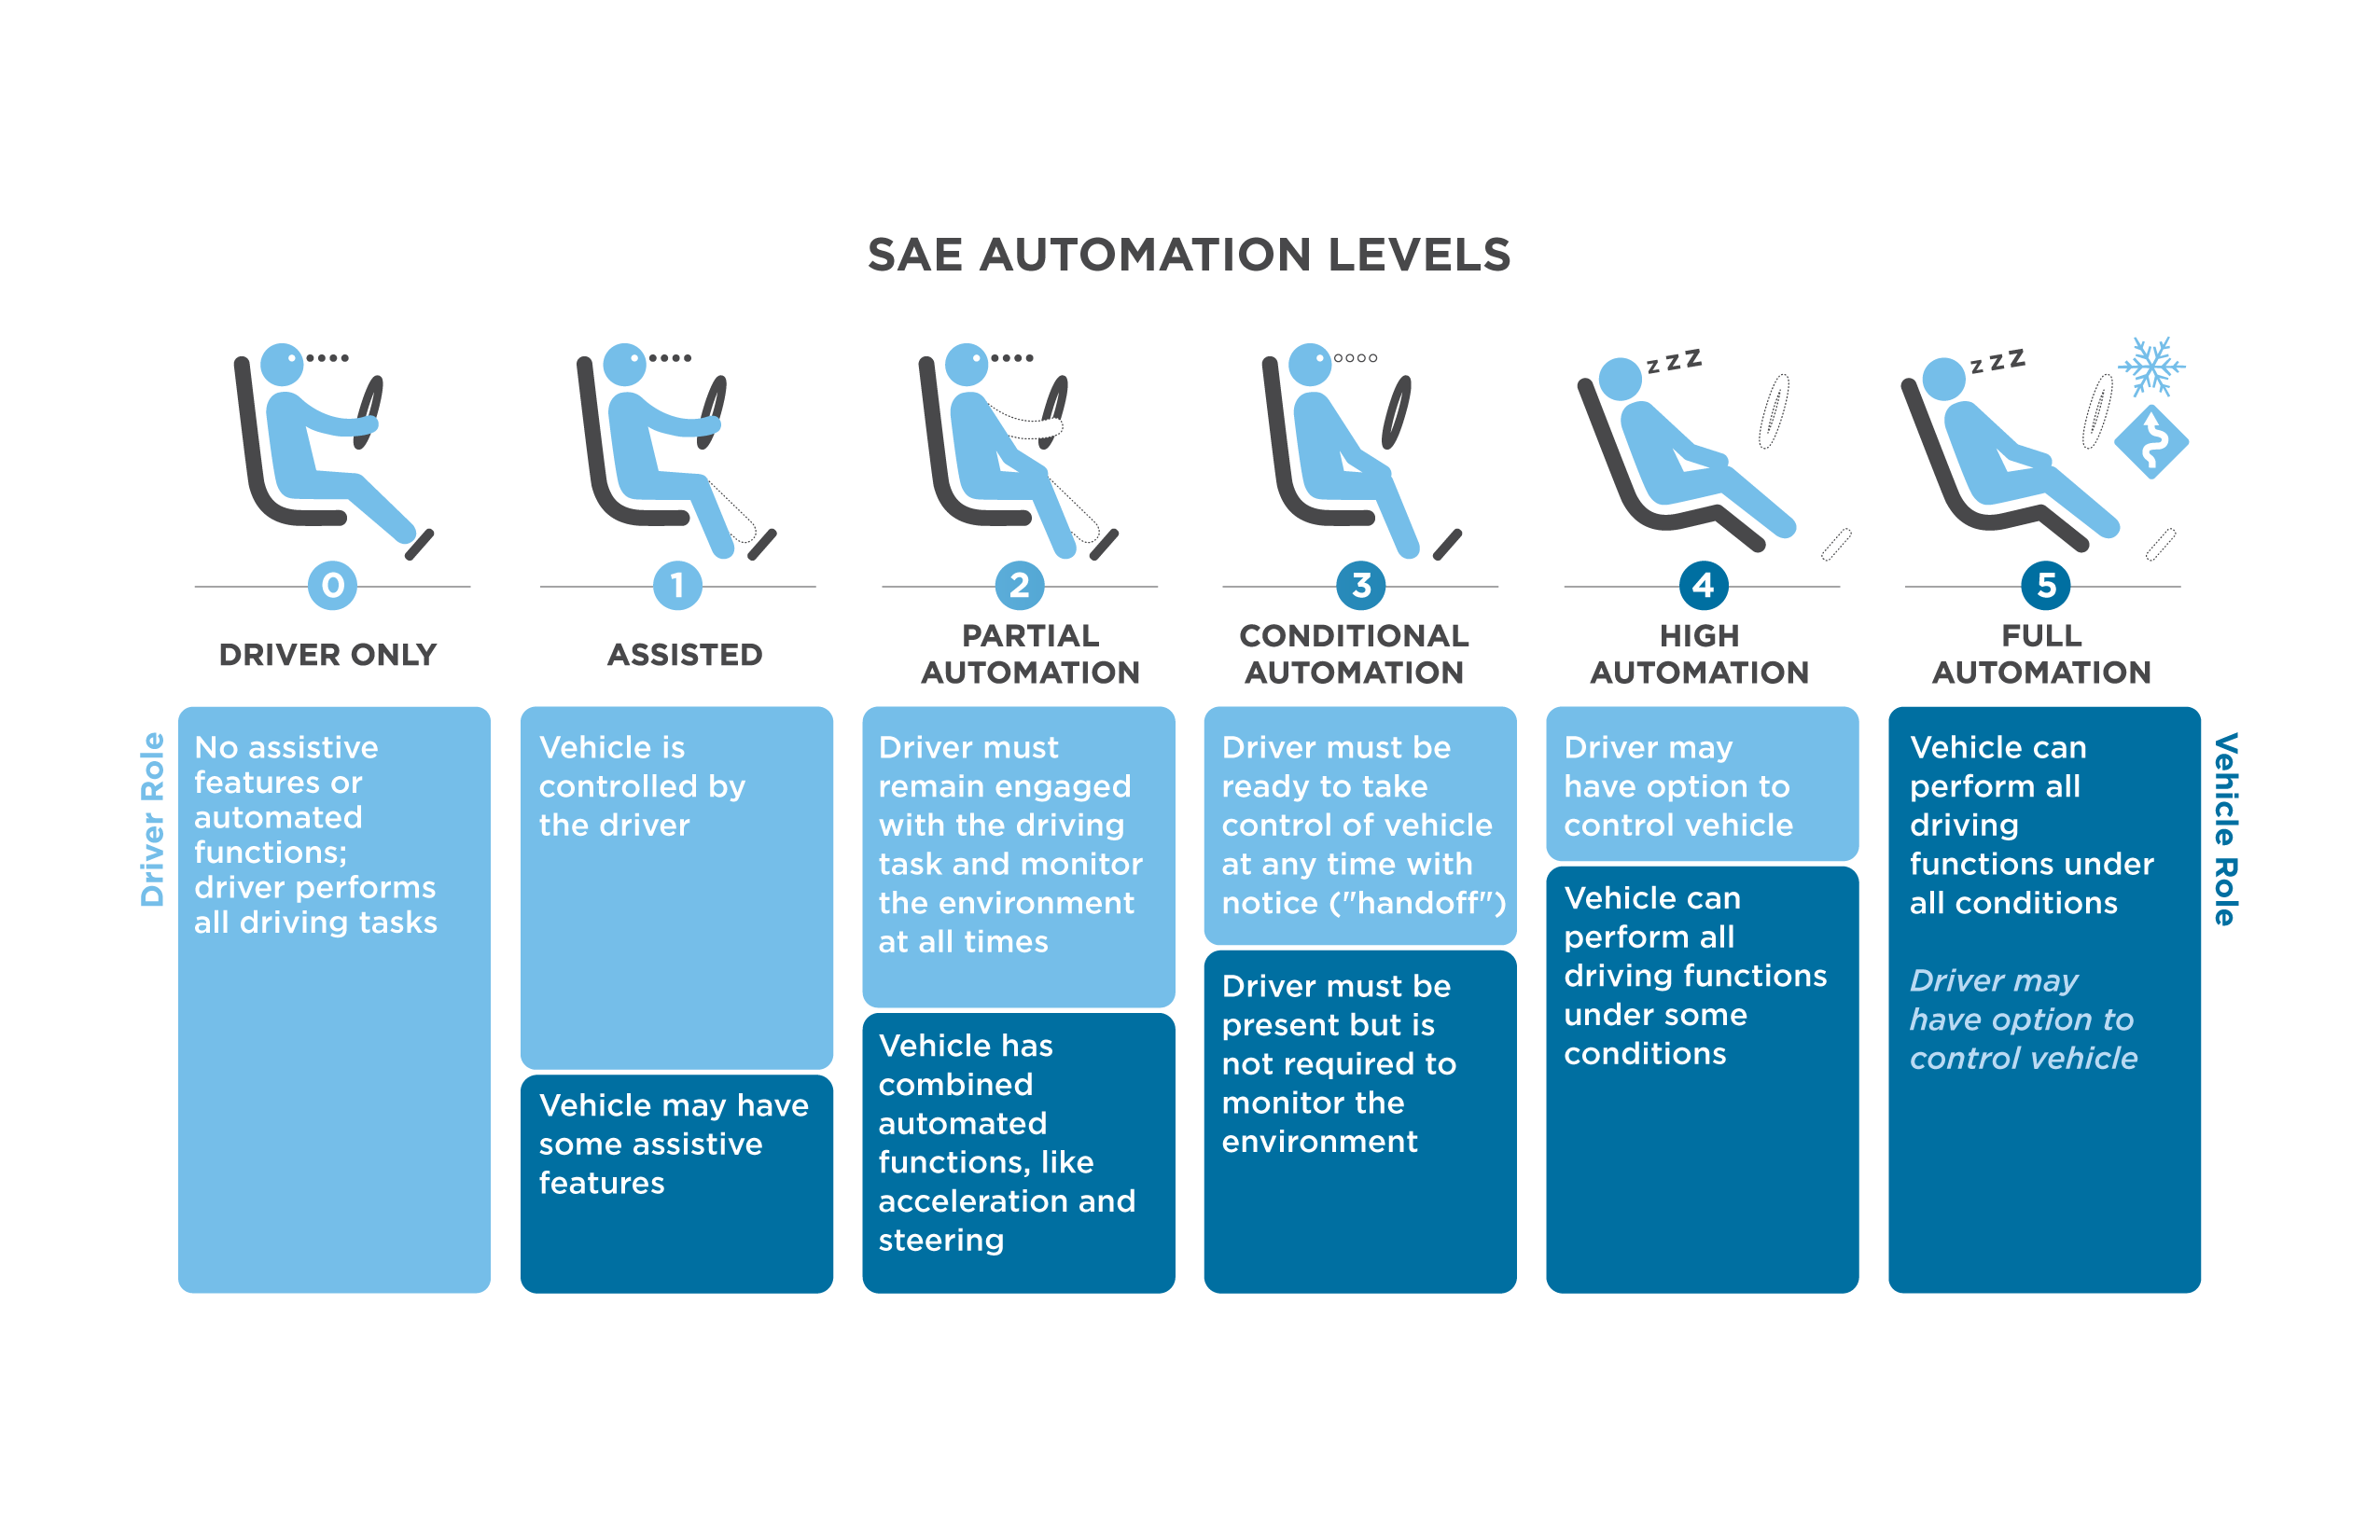
NHTSA has adopted a framework for automated driving, which categorizes automation into six levels.
Notes:
The Society of Automotive Engineers (SAE) International has categorized the levels of automation into six levels (see sidebar). Two critical differentiators among these levels is determining who is in control of the car at any point in time—the human operator or the vehicle software/hardware—and whether or not the operator needs to remain alert, ready to resume control of the vehicle.

Slide 5
CAVs put pressure on traditional planning assumptions.
This study provides information about how state DOTs and MPOs can begin accounting for CAVs in planning and modeling activities.
New assumptions may need to address:
Transportation Cost Impacts
Transportation Safety Impacts
Vehicle Operations Impacts
Electrification (fuel) impacts
Personal mobility and convenience impacts
Notes:
Expected areas of impact from CAVs on travel behavior are critical considerations for planners and modelers. These are:
Transportation cost impacts: The economics of CAV technology imply that vehicle cost will certainly rise, but the cost per mile may decrease. However, the overall transportation cost to the consumer is uncertain and is most likely tied to vehicle ownership versus distributed vehicle ownership, vehicle club membership, or ride sharing.
Transportation safety impacts: A reduction in crashes would improve the reliability of travel times and reduce property damage, injuries, and fatality crashes. As of yet, the evidence is still building on the safety impacts.
Vehicle operations impacts: Much research has focused on the impact of connecting vehicles dramatically shortening headway space and thereby improving coordinated acceleration and vehicle throughput. The coordination of flow, through the concept of synchronized arrivals and reserved time/space, may indeed prove to reduce queuing and congestion. But is unproven.
Electrification (Fuel) impacts: . If shared AVs are used, the user would not need to be concerned with refueling because the fleet owner/operator would use optimizing algorithms to reduce cost. This could impact the petroleum industry, fuel delivery services, gas station land use, and the need for strategically located electric refueling stations.
Personal mobility and convenience impacts: With CAVs, the prospect of the elderly, young teens, and mobility-limited individuals gaining increased transportation freedom could greatly improve. But the overall impact on the (dis)utility and (in)convenience of travel time—a key component of the value of travel time—from CAV technology is uncertain. How will the perception of the cost of travel time will change if more operators become passengers in SAVs and if the capital cost of vehicle ownership is replaced by paying on a per-trip basis.

Slide 6
Adoption timelines remain uncertain; three general phases of adoption are assumed.
Early Deployment
Fleet Turnover every 7 years
Initial Adoption
Road operators need to implement coordinated rules of the road for their safe operation.
Predominant Adoption
Usage will be widespread enough to achieve systematic route and flow optimization
Could take decades to reach full automation
  Modeling and planning tools can be developed to address the short-, mid-,
  and long-term impacts to travel behavior that each of these phases promulgates.

Slide 7
The context of planning for CAV technology is one of deep uncertainty.
Qualitative Methods
Quantitative Methods
Scenario Planning
  Has limitations in linking multiple, diverse futures to near-term policy choices
Assumption-based Planning
  Has evolved to address limitations in scenario planning
Robust Decision Making (RDM)
Infogap
Dynamic Adaptive Pathways Planning (DAPP)
Rather than ask, “What will happen?” these methods ask, “What should we do today to most effectively manage the range of events that might happen?”
Notes:
The framework presented on the previous slide suggests a simple idea: the longer the planning horizon, the less certainty about predictive processes. The report explains two qualitative and three quantitative methods for addressing uncertainty in the planning context.
The most common qualitative method for addressing uncertainty is scenario planning. Assumption-based planning hinges on identifying load-bearing assumptions (assumptions that, if broken, would require major revision of the course of action) and, subsequently, the vulnerability of those load-bearing assumptions in future conditions.
RDM runs models over hundreds to thousands of different sets of assumptions to describe how plans perform in many plausible conditions. These model runs are used to stress-test strategies and helps decision makers identify robust strategies—those that perform well regardless of the assumptions or future conditions. Info-gap uses models to compute how options perform as a function of uncertainty and , it informs decision makers on trade-offs, risks, and vulnerabilities. Dynamic adaptive pathways planning (DAPP) approach starts from the premise that policies or decisions have a design life and might fail as the operating conditions change. Once actions fail, other actions are needed to achieve objectives, and a series of pathways emerge. By exploring different pathways, planners can design an adaptive plan that includes short-term actions and long-term options. The plan is monitored for signals that indicate when the next step of a pathway should be applied or whether reassessment of the plan is needed.

Slide 8
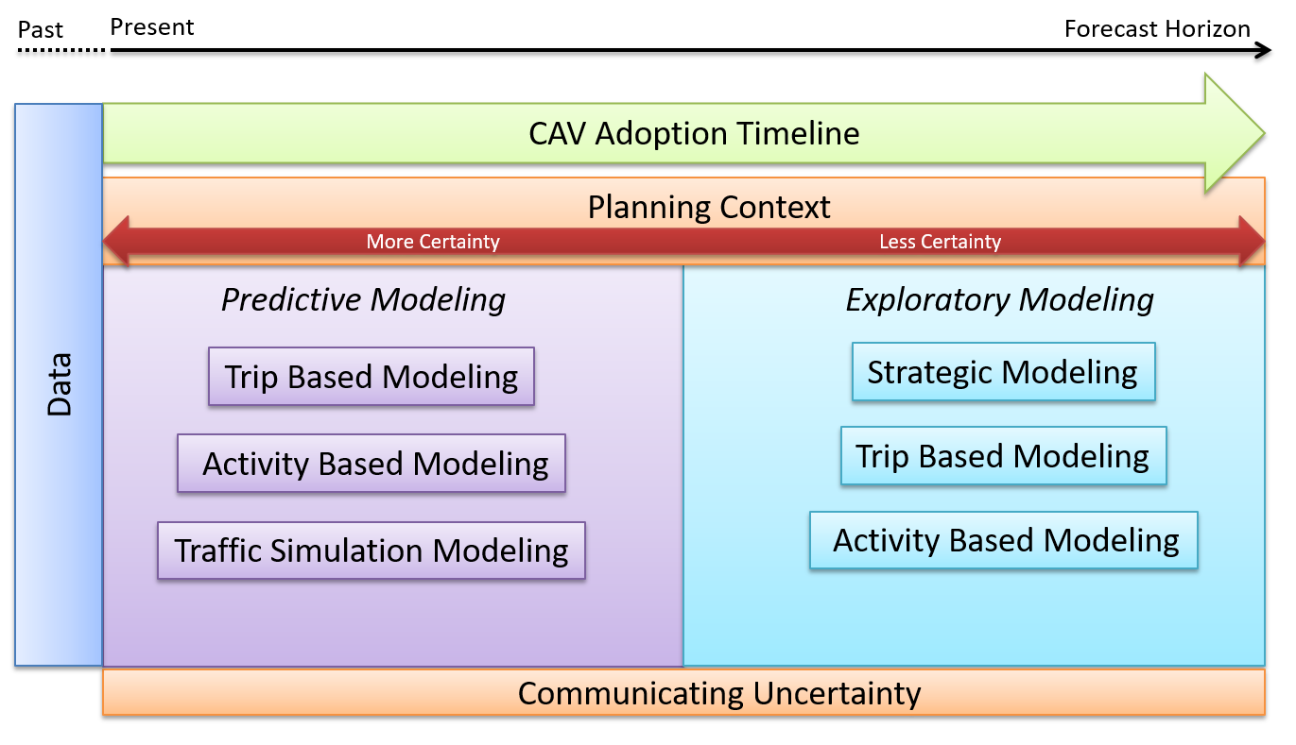
Exploratory modeling is more useful for understanding uncertain futures.
Notes:
A framework for forecasting CAVs includes five elements: Data, Planning context, Modeling, CAV adoption timeline, Communication of uncertainty.
The first three elements of data, planning, and modeling combine to create a forecasting environment. The typical planning process includes developing a vision for transportation in a region, setting goals and performance measures as targets, collecting data, building models from the data, and using models in either a predictive or exploratory mode to evaluate alternative transportation investments.
The fourth aspect, the CAV adoption timeline, indicates that data are collected in the past and planning occurs in the present time. The CAV adoption timeline box/arrow indicates that an agreement needs to be made on the level of adoption/advancement of CAV technology—and the rate of adoption of the technology—over the planning/modeling timeline period. No assumed time period is indicated in the diagram. Communication is the last element. It involves the need for the analyst to convey the level of uncertainty associated with the model results to decision makers and stakeholders. Using this framework, a situation that analysts commonly face is a de facto interpretation of results as predictive. A better method is to determine at initial project scoping if the analysis is going to be based on predictive, data-supported modeling or on exploratory techniques, which should not be taken as a prediction.

Slide 9
The CAV framework addresses three types of modeling systems.
Trip-based models are developed as aggregate models of population and employment in a region with disaggregate measures of transportation supply and an aggregate assignment process.
Activity-based (AB) and dynamic traffic assignment (DTA) models are developed as disaggregate models of persons and firms in a region with disaggregate measures of transportation supply.
Strategic models are developed as disaggregate models of persons and firms in a region with aggregate measures of transportation supply.
  The following slides present a panorama of the possible
  with respect to model adaptations. Which ones to implement depend on what one hopes to learn from the models.
Notes:
Strategic models are typically applied in a scenario planning context to evaluate the impacts of a variety of policies and investments. Trip-based and AB or DTA models are applied to explore detailed impacts of policies and investments on the transportation system. However, these three modeling systems also could be applied in parallel to provide a range of potential options to address uncertainty in CAV planning and modeling.
It is important to note that the point in adapting models for CAV is to select the sensible adaptations based on what we hope to learn from the models. It makes no sense to blindly build in more and more adaptations as a way of addressing uncertainty. More complex models will not by themselves lead to better planning outcomes.

Slide 10
Adapting Trip-Based Models to CAVs
Trip-based models are long-range travel demand models that follow the conventional four-step process of trip generation, trip distribution, mode choice, and traffic assignment.
These models have been calibrated, validated, and tested throughout the world, and they are used extensively across most MPOs and state DOTs.
The study report discusses adapting the following components of trip-based models to account for CAVs: Land use modeling, Auto availability and mobility choices, Trip generation, Trip distribution, Mode choice, Routing and traffic assignment.

Slide 11
Potential Changes to the Trip-based Modeling System from CAV Impacts
Model Component | Trip-Based Model Improvements
Sociodemographics
Land use/demographic model | Account for parking reuse, new mobile populations
Market/Fleet Models
Fleet composition models | Estimate and forecast types of vehicles and technology
Auto Ownership Models
Auto ownership | Estimate and forecast CAV or manual vehicle ownership
Auto availability | Estimate and forecast availability of SAVs and carsharing
Trip Generation
Trip rates | Estimate rates for new mobile populations, account for zero-occupant trips, adjust rates for improved accessibility
Trip Distribution
Impedance to travel | Estimate network cost & friction factor matrices for CAVs
Mode Choice
Mode choice model | Design new nesting structure: CAVs, SAVs, and SAV to transit; account for MaaS impacts to multimodal tour plans
Value of time | Account for improved value of time for CAV modes
Notes:
Potential changes include:
New sub-models.
CAVs.
SAVs.
SAV access to transit.
Additional sub-models.
Auto availability models that reflect the level of market penetration of CAVs.
Market penetration models to determine fleet composition changes over time.
New algorithms/processes.
Routing routines to model dynamic ridesharing (e.g., Uber Pool).
Coordinated multimodal mobility services modeling (e.g., MaaS).Network flow coordination (real-time speed governing and predicted arrival rates).
New supply models to reflect CAV impacts on roadway space.

Slide 12
Adapting Activity-based and Dynamic Traffic Assignment Models to CAVs
The primary difference between AB methods and more traditional trip-based methods is that AB models incorporate a more flexible and detailed simulation of human behavior.
Using disaggregate discrete choices tends to make the model structure more flexible and able to incorporate several different levels and types of choice behavior. The flexibility is valuable in incorporating new aspects of travel behavior that may be associated with CAVs.
DTA can represent detailed differences in the ways that human operators and AVs will navigate road networks and are a promising approach for learning how CAVs will influence traffic capacity and congestion levels.
Notes:
In AB models, the travel of each individual household and person in the region is simulated across the course of a day. Trips are simulated as parts of home-based trip chains (tours), and tours are scheduled within the time available during the day. Travel decisions are simulated as discrete choices based on the model probabilities.

Slide 13
Typical Disaggregate AB and DTA Model Components
Notes:
The typical disaggregate modeling system focuses on individual characteristics of the people and vehicles in the system. DTA reveals traffic congestion levels and effective capacities through the simulation of how vehicles navigate the roads and intersections. Because no observed data exist on how the introduction of CAVs will affect aggregate speed-flow relationships, the use of DTA may be the most promising approach for learning how CAVs will influence traffic capacity and congestion levels. Use of DTA methods for region-wide long-range forecasting is still in the initial implementation stages, but combining DTA with AB demand models may become more widespread in the future as the methods and software mature and network data become more plentiful and accessible.

Slide 14
Potential Changes to AB and DTA Modeling System from CAV Impacts
Model Component |  | Disaggregate AB/DTA Model Improvements
Mobility Models
Vehicle own | Add CAVs as an option, add purchase cost, parking cost | Add CAVs as an option for households to own
Shared mobility | Add carsharing, ride-hailing, bikesharing memberships | Add carsharing, ride-hailing, bikesharing memberships
Activity Generation and Scheduling
Activity generation |  | Lift age restrictions for CAVs, adjust VOT, add empty car trips
Destination/Location Choice
Work/school locations |  | Integrate with land use model to provide sensitivity
Mode Choice
Mode choice |  | Add new modes; adjust VOT for CAVs
Access/egress |  | Add new access and egress modes
Mode choice |  | Add dynamic pricing, adjust parking costs for CAVs
Parking choice |  | Add parking choice model to include off-site parking
Routing and Traffic Assignment
Vehicle operations |  | Track empty vehicles and their travel characteristics
Dynamic assignment |  | Simulate different levels of CVs in mixed traffic
Pricing
Cost models |  | Determine cost per mile for each new mode by time period
Notes:
The study report discusses adapting the components of AB and DTA models to account for CAVs: Sociodemographics, Land use/built environment, Auto ownership/mobility models, Activity generation and scheduling, Destination/location choice, Mode choice, Routing and traffic assignment, Pricing, Truck and commercial vehicles.

Slide 15
Adapting Strategic Models to CAVs
Strategic models are intended for use as visioning tools, specifically to help guide transportation policies and investments.
Several forms of strategic models have been developed in recent years for transportation planning to address a gap in the technical understanding of an uncertain future.
The current strategic visioning frameworks were designed to be faster, allowing for extensive scenario testing.
Strategic models run many (even hundreds of) scenarios quickly, so that visualizers can interpret them interactively to assess the impacts derived from various combinations of policies and investments.
Notes:
Strategic models for used as visioning tools have existed in various forms for a long time. They are designed for fast processing speed. Processing speed is accelerated by not including detailed multimodal transport networks but describing the built environment and transportation supply using aggregate measures. These models are developed and applied as disaggregate models, maintaining detailed personal, household, and firm characteristics that influence travel demand, combined with the aggregate land use and transport supply measures.

Slide 16
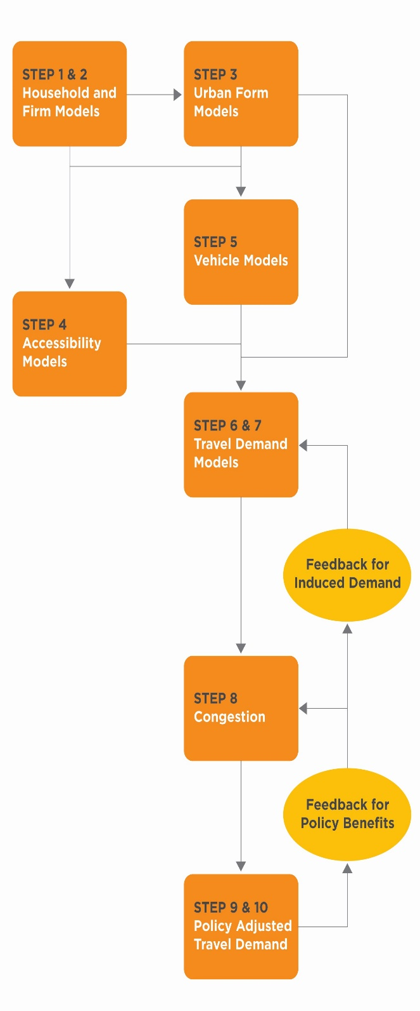
Typical Strategic Model Components
Notes:
Another important feature of strategic visioning frameworks is ensuring that the interaction between different policies or future scenarios is integrated so that population, land use, employment, transport supply, and travel behavior are linked. These linkages are important to understand how the combination of policies or transport supply or demographics on travel demand can influence each other (and not be double-counted). Sometimes transport policies target similar demographic populations and are more or less effective in combination with other policies. The land use and transport interactions are used to quantify induced demand for travel, which is a critical aspect of uncertain futures.

Slide 17
Potential Changes to Strategic Models from CAV Impacts
Model Component | Strategic Model Improvements
Mobility Models
Vehicle ownership | Add household vehicle ownership costs for CAVs
Vehicle age model | Represent higher turnover for buying CAVs
Vehicle choice | Add household AV choice model for vehicle use
Pricing
Household budgets | Incorporate all aspects of cost for CAVs and MaaS
Parking costs | Segment parking cost
Travel Demand Models
VMT model by vehicle type | Adjust VMT for households owning CAVs
VMT model by vehicle type | Add VMT for fleet-owned CAVs
Feedback for congestion | Separate VMT models for AVs and SAVs
Feedback induced demand | Add VMT adjustment for induced demand
Mode Choice
VMT by mode | Add CAVs and TNCs based on cost per mile
Truck and Commercial Vehicles
Vehicle type/short haul | Add choice model for light/med/heavy trucks and AV/drones
CV VMT model | Add feedback for congestion
Notes:
The study report discusses adapting the following components of strategic models to account for CAVs: Sociodemographics, Built environment, Mobility, Accessibility, Travel demand, Mode choice, Pricing, Truck and commercial vehicles.

Slide 18

Planners and modelers are challenged to communicate uncertainty with decision makers.
Planners must:
Communicate what they are certain about while being clear about uncertainties.
Learn to explain that we can’t model our way out of uncertainty.
Use models to understand
sources and consequences
of uncertainty.
Notes:
As the transportation planning industry strives to find ways to anticipate impacts under highly unstable conditions, planners and modelers are also challenged to communicate this uncertainty with senior decision makers and elected officials. How does a responsible planning or modeling professional present forecasts that are steeped in uncertainty without leaving decision makers in high-risk situations and leaving stakeholders suspicious? The goal should be to intentionally communicate what we are certain about while being clear about uncertainties, and to emphasize where there is control while being honest about where there is no control. Planners must learn to explain that we can’t model our way out of uncertainty, but we can use models effectively to understand it sources and its consequences.

Slide 19
While different agencies have unique needs, all should develop new planning and modeling processes for CAVs in the transportation environment.
MPOs and DOTs should consider adapting their planning processes to address the uncertainties posed by future CAV deployment and use.
Models can inform decision-making under uncertainty, but they cannot reduce that uncertainty.
Careful attention to model assumptions is the key to risk management and confident decision-making.
Notes:
Different MPOs and DOTs have unique needs when addressing the uncertainties posed by future CAV deployment and use. While the approach to development of methods may differ among regions and states, what all agencies have in common is the need to develop new planning and modeling processes that include CAVs in the transportation environment. Go to slide text.

Slide 20
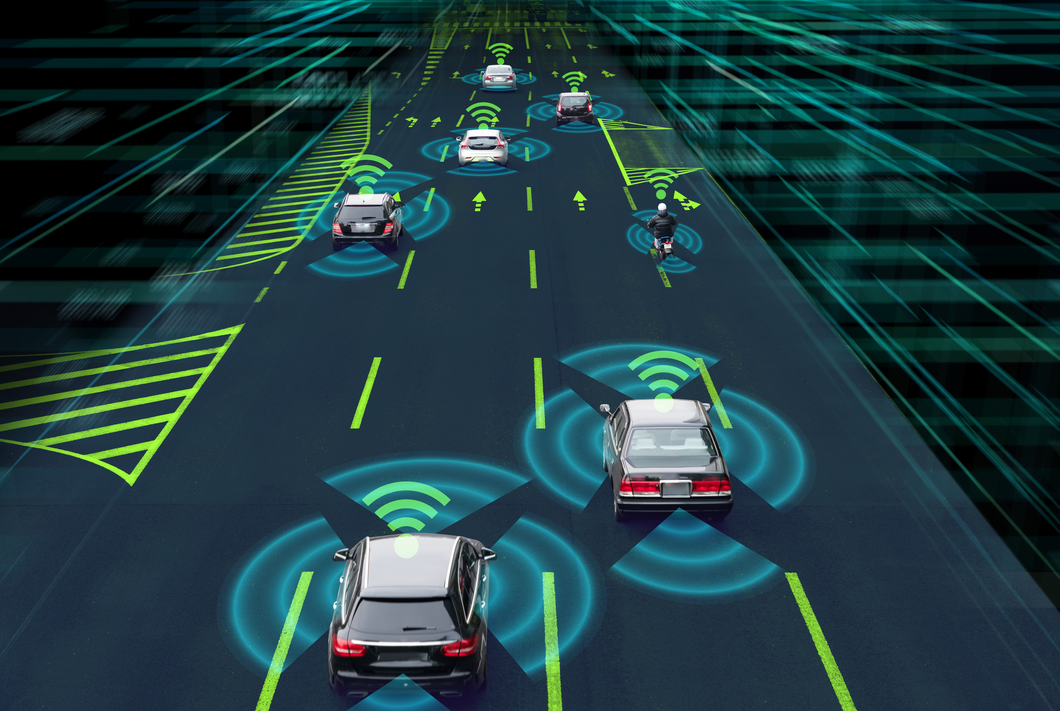
NCHRP 20-102(9) Providing Support to the Introduction of CAV Impacts into Regional Transportation Planning and Modeling Tools
Research Team
Johanna Zmud, Texas A&M Transportation Institute
Tom Williams, DKS Associates
Maren Outwater and Mark Bradley, Resource Systems Group, Inc.
Nidhi Kalra, RAND Corporation
Shelley Row

