Slide 1
A Simulation-based Approach to Capacity Constrained Mandatory Location Choice Models: An ActivitySim Implementation
Ali Etezady, David Hensle, Joel Freedman
Innovations in Travel Analysis and Planning Conference
Indianapolis, Indiana
June 5, 2023

Slide 2
Content
Background
New approach
Implementation & results
Conclusion

Slide 3
Background

Slide 4
Background
Mandatory location choice models are integral parts of Activity-based models and are also increasingly common in trip and tour-based models.
They determine the workplace or school location of individuals in the model.
These models are often formulated using the logit family of random utility models.
Advantages: flexibility in defining the factors affecting choice, efficiency of the method, and the general availability of estimation software packages
Disadvantage: (in general) inability to doubly constrain the model in the estimation process, requiring an iterative post-estimation process to match input attractions

Slide 5
Background: the need to doubly constrain choice models
A location choice model by design ensures matching the origin constraints.
The sum of the number of workers with assigned workplace matches the total number of workers
But it does not ensure matching the destination constraints
No guarantee the number of assigned workers to a destination zone matches available jobs there.
Origin constraint:
$$\sum_{j}{P_{i,j} ∗{Workers}_{i}={Workers}_{i}}$$
(given, since
$\sum_{j}{P_{i,j} =}1.0$)
$$P_{i,j}=\frac{e^{U_{i,j}}}{\sum_{i,j}{e^{U_{i,j}}}}$$
Destination constraint:
$$\sum_{i}{P_{i,j} ∗{Workers}_{i}={Employment}_{j}}$$

Slide 6
Background: solution
Solution 1: estimate constrained location choice models
Hard to solve and expensive to run ^{[1]}
Not guaranteed to match input attractions in implementation
Solution 2: constrain the model after estimation.
Use shadow pricing: an iterative process in which constants are added to the utility of each destination alternative and adjusted so that the model output matches the destination constraints
[1] Bernardin, V., S. Trevino, G. Slater & J. Gliebe. “Simultaneous Travel Model Estimation from Survey Data and Traffic Counts.”

Slide 7
Calculation of shadow prices
Shadow prices are usually calculated in one of two ways
Additional alternative-specific constant for each destination zone
$$P_{i,j}=\frac{e^{U_{i,j}}}{\sum_{i,j}{e^{U_{i,j}}}}$$
Sample Utility Equation:
U_{j} = β_{logsum} * logsum_{ij} + β_{dist} * dist_{ij}
+ ln(retail_emp_{j} + θ_{service_emp} * service_emp_{j})
+ $C_{j}$
(quality variables)
(quantity variable - size)
(shadow price)
where:
$$C_{j}=\ln\left[\frac{Employment\text{j}}{Workers\text{j}}\right]$$
(requires iteration)

Slide 8
Calculation of shadow prices
Shadow prices are calculated in one of two ways
Additional alternative-specific constant for each destination zone
Multiplier on size term
$$P_{i,j}=\frac{e^{U_{i,j}}}{\sum_{i,j}{e^{U_{i,j}}}}$$
Sample Utility Equation:
U_{j} = β_{logsum} * logsum_{ij} + β_{dist} * dist_{ij}
+ ln(retail_emp_{j} + θ_{service_emp} * service_emp_{j})
* $C_{j}$
(quality variables)
(quantity variable - size)
(shadow price)
where:
$$C_{j}=\frac{Employment_{j}}{Worker\text{s}\text{j}}$$
(requires iteration)

Slide 9
Purpose and need
Shadow pricing is slow
Most activity-based models use a process called ‘shadow pricing’ to ensure that total workers who choose to work in a zone is proportional to the total input employment in the zone
The models do this by running the work location choice model, comparing total workers to total input employment, and calculating a ‘shadow price’, or zonal adjustment factor, to use in the next iteration.
The process is repeated until the model ‘converges’.
This is a slow process.

Slide 10
Purpose and need
Shadow pricing is not guaranteed to converge
Because of the way that the prices are calculated (by segment), there’s no guarantee that total workers will equal total input employment after any number of iterations.
The procedure does not consider in-commuting or out-commuting, which can be problematic for regions with big neighbors.

Slide 11
Purpose and need
Managing shadow prices is a pain
There are no definitive rules for when this process should be run, and when it can be turned off to save runtime.
If shadow pricing is turned off, some other version of shadow prices is typically used as an input. But its not clear which prices should be used or how good they are.
Shadow prices also don’t work very well with small sample sizes.

Slide 12
Simulation Approach

Slide 13
Revised constraint mechanism
We created a new simulation-based constraint mechanism in ActivitySim that greatly speeds up runtime and accuracy
Runs all workers through location choice
For each zone, compare estimated workers to total input employment. If zone is over-estimated, randomly select workers (equal to the number over the total jobs) and re-run them in the next iteration after removing all over-estimated zones.
The new procedure is much faster than shadow pricing and is guaranteed to converge. And no more shadow prices to manage.

Slide 14
Revised Approach
Set workers_to_simulate = ALL
Run model with all workers_to_simulate
$$C_{j}=\frac{Employment\text{j} \text{/}\sum{Employment\text{j}}}{Workers\text{j} \text{/}\sum{Workers\text{j}}}$$
Calculate C_{j} each zone
All C_{j} = 1+ tol
Quit
C_{j} < 1
Set Shadow_price_{j} = -999
Set n_{j} = extra number /share of workers from zone j
Set Shadow_price_{j} = 0
Set n_{j} = 0
No
Yes
Sample n_{j} from each zone
Set workers_to_simulate = n = union(n_{j})

Slide 15
Implementation

Slide 16
Implementation
The simulation-based method was implemented within the ActivitySim framework, an open-source activity-based travel demand modeling platform.
Capacity constraint method can be set in the model’s shadow pricing settings file.
Previously, ActivitySim had the option of the usual shadow pricing methods (multiplier on size term or additive constant).
These options can be turned on for workplace location or school location choice models.
Target data (zonal employment or enrollment come form the land use data).

Slide 17
Testing & results

Slide 18
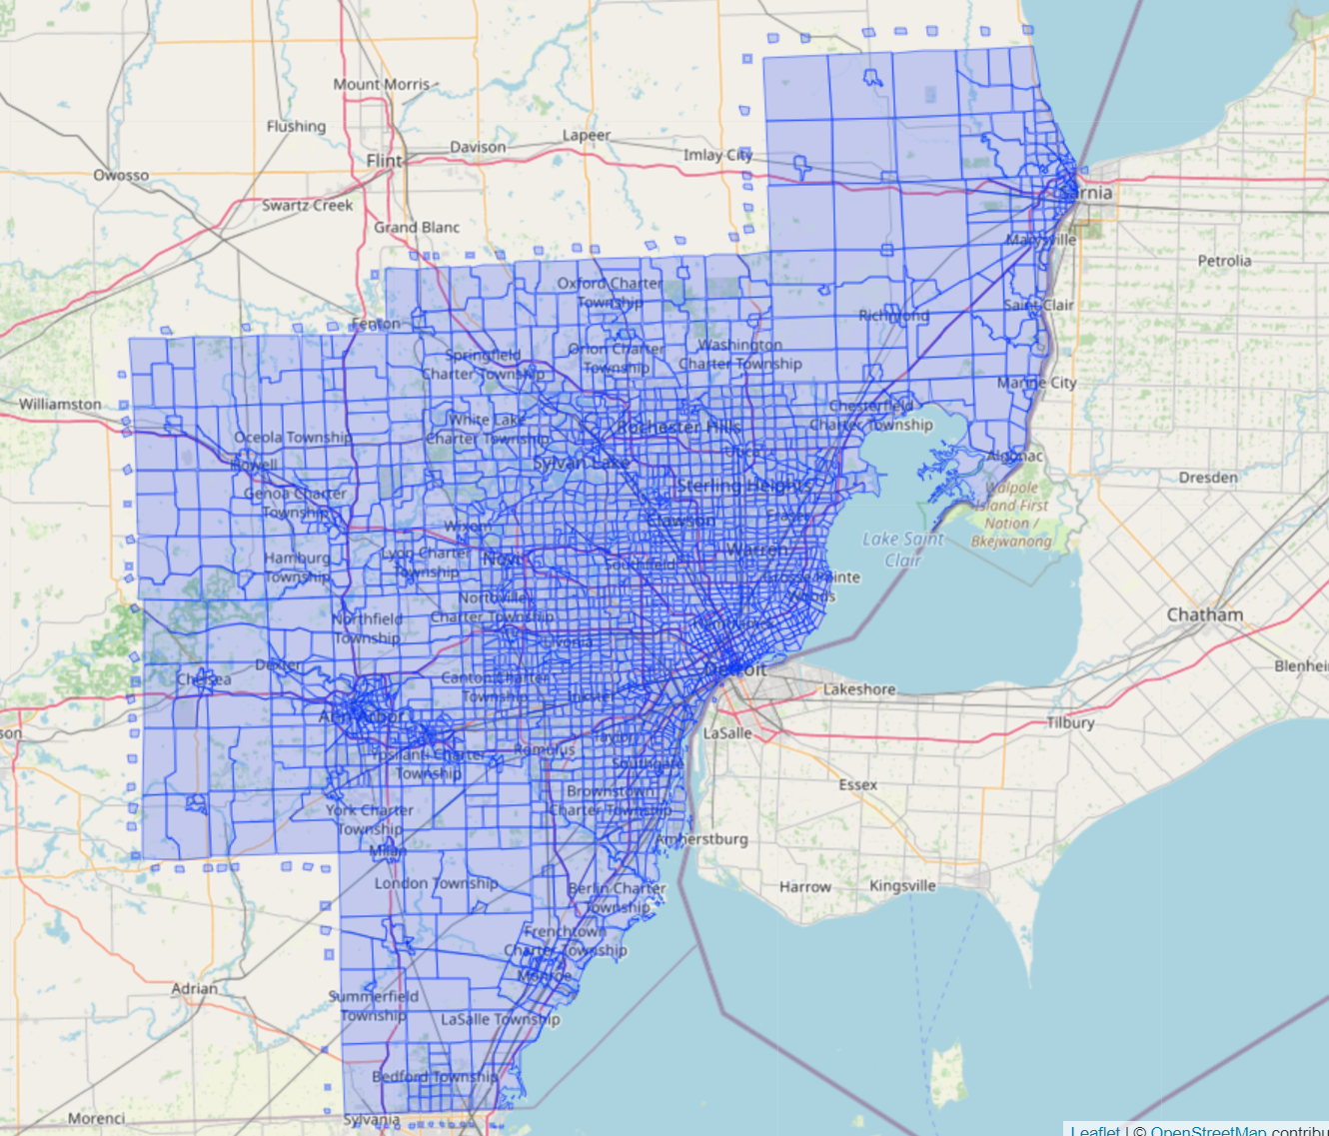
We Use the SEMCOG model for testing
(Southeast Michigan Council of Government) SEMCOG model:
1.9m households
4.7m persons
28600 zones (microzone)
Workplace location model tested
Convergence criteria:
Modeled size (share of workers in MAZ) within 5% of desired size (share of employment in MAZ)
Maximum of 1% of zones allowed to fail to meet above target

Slide 19
Workplace location choice constraining: convergence

Slide 20
Percent of MAZs not reaching convergence
Note: convergence for legacy method is based on proportion of workers in MAZ compared to proportion of size term in MAZ
There are four size term segments (by income group) so if any of the four fail to reach convergence, MAZ is flagged as failing for shadow pricing method

Slide 21
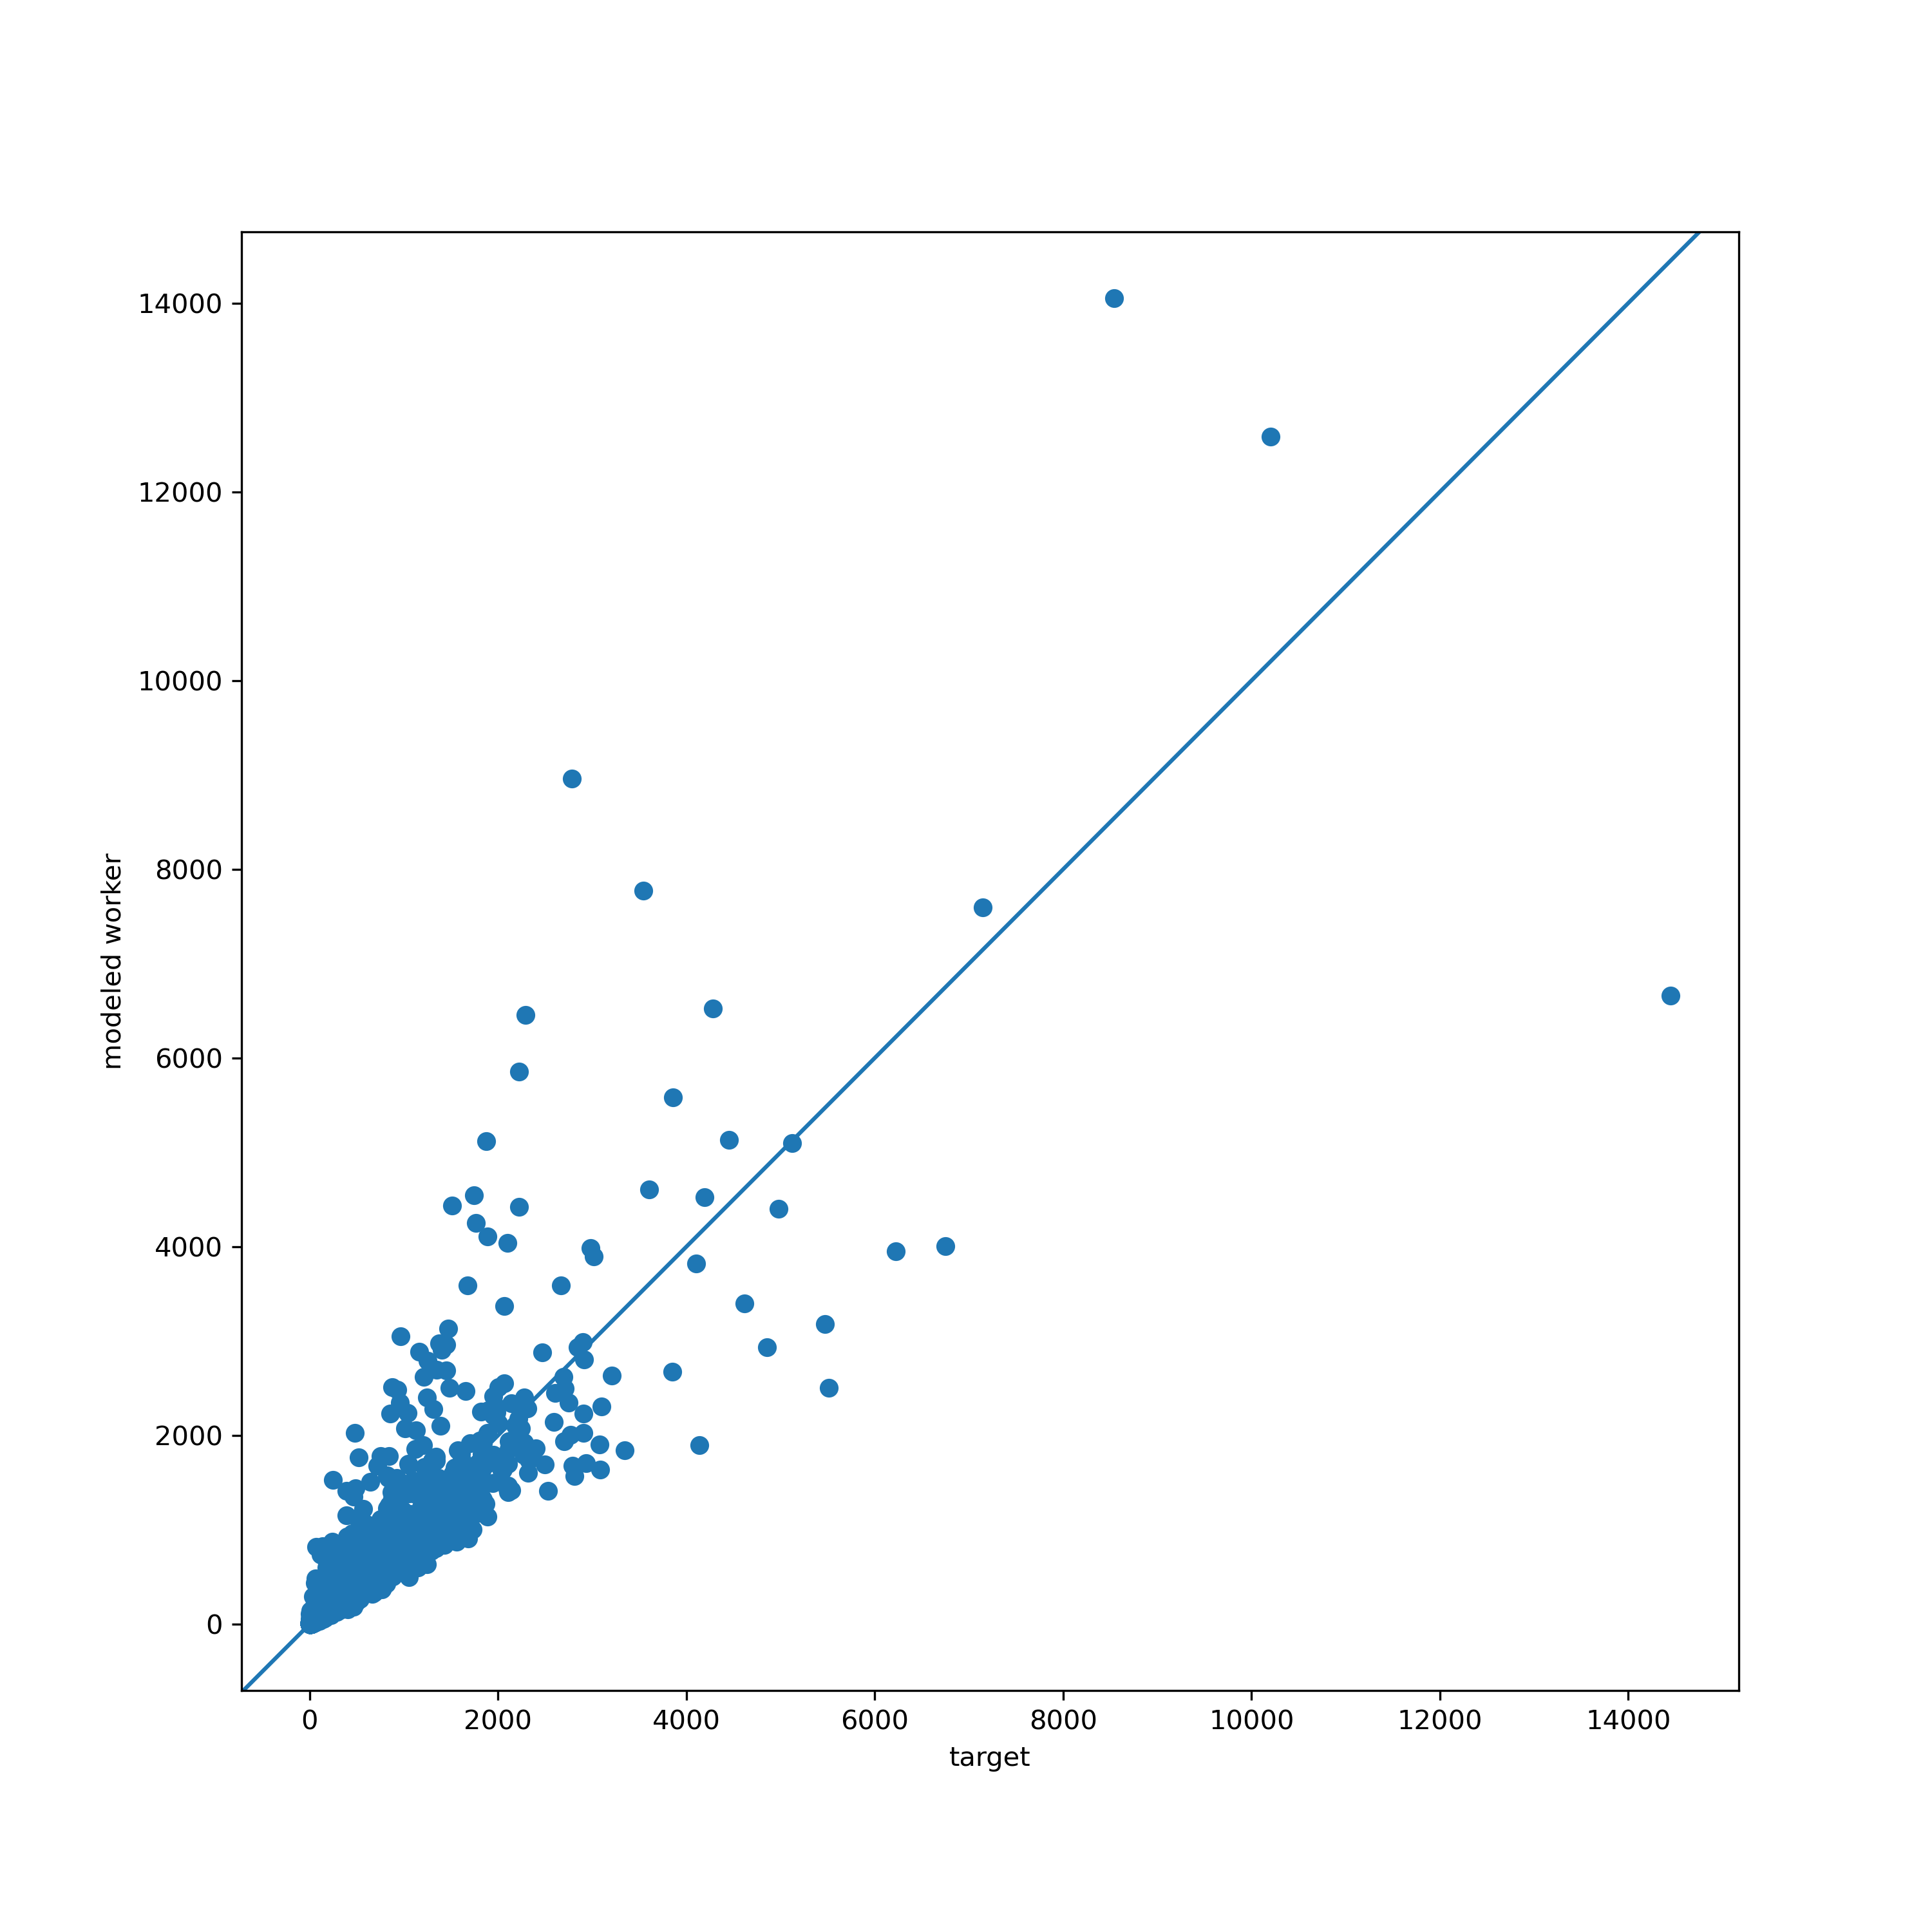
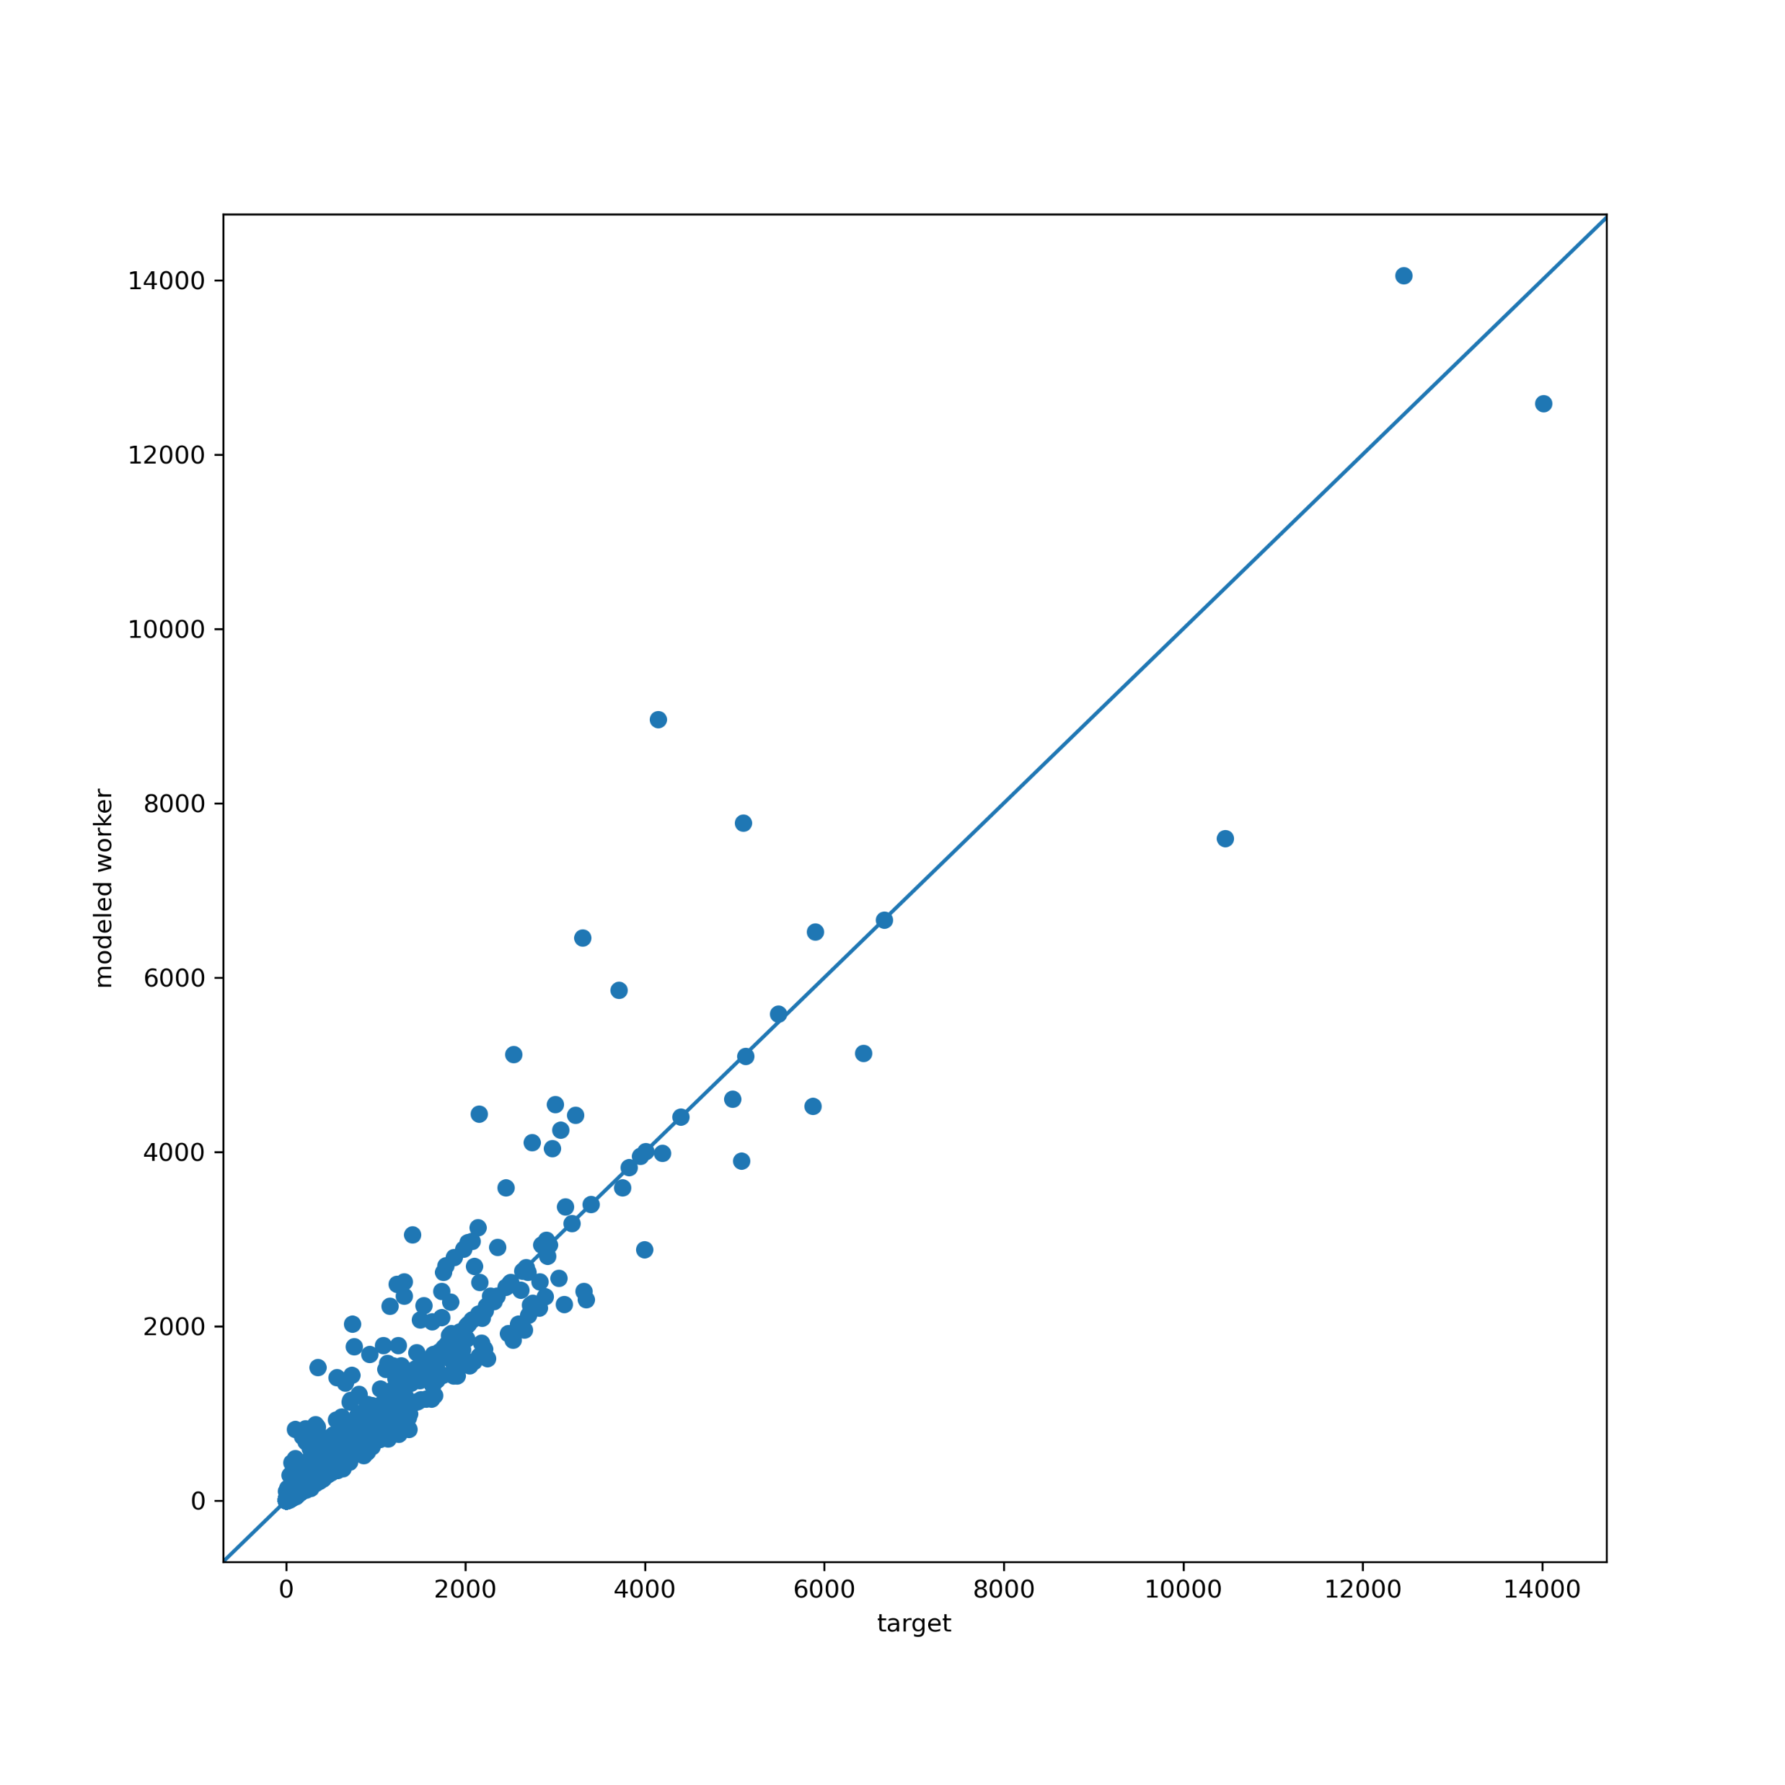
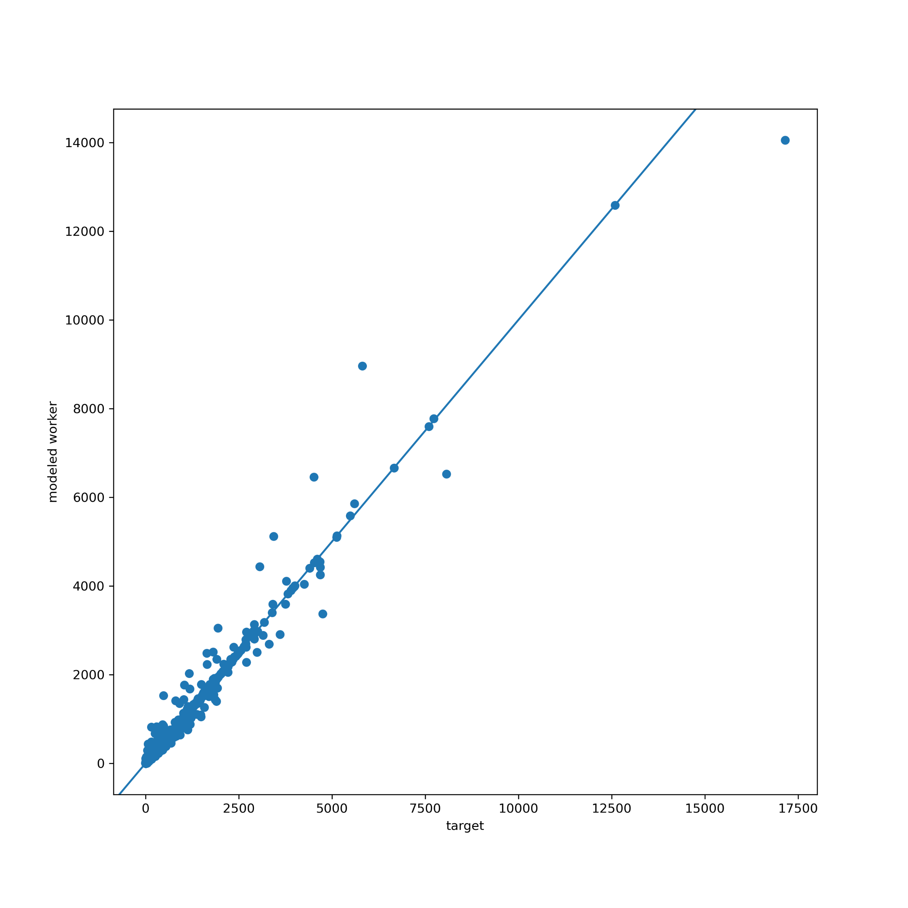
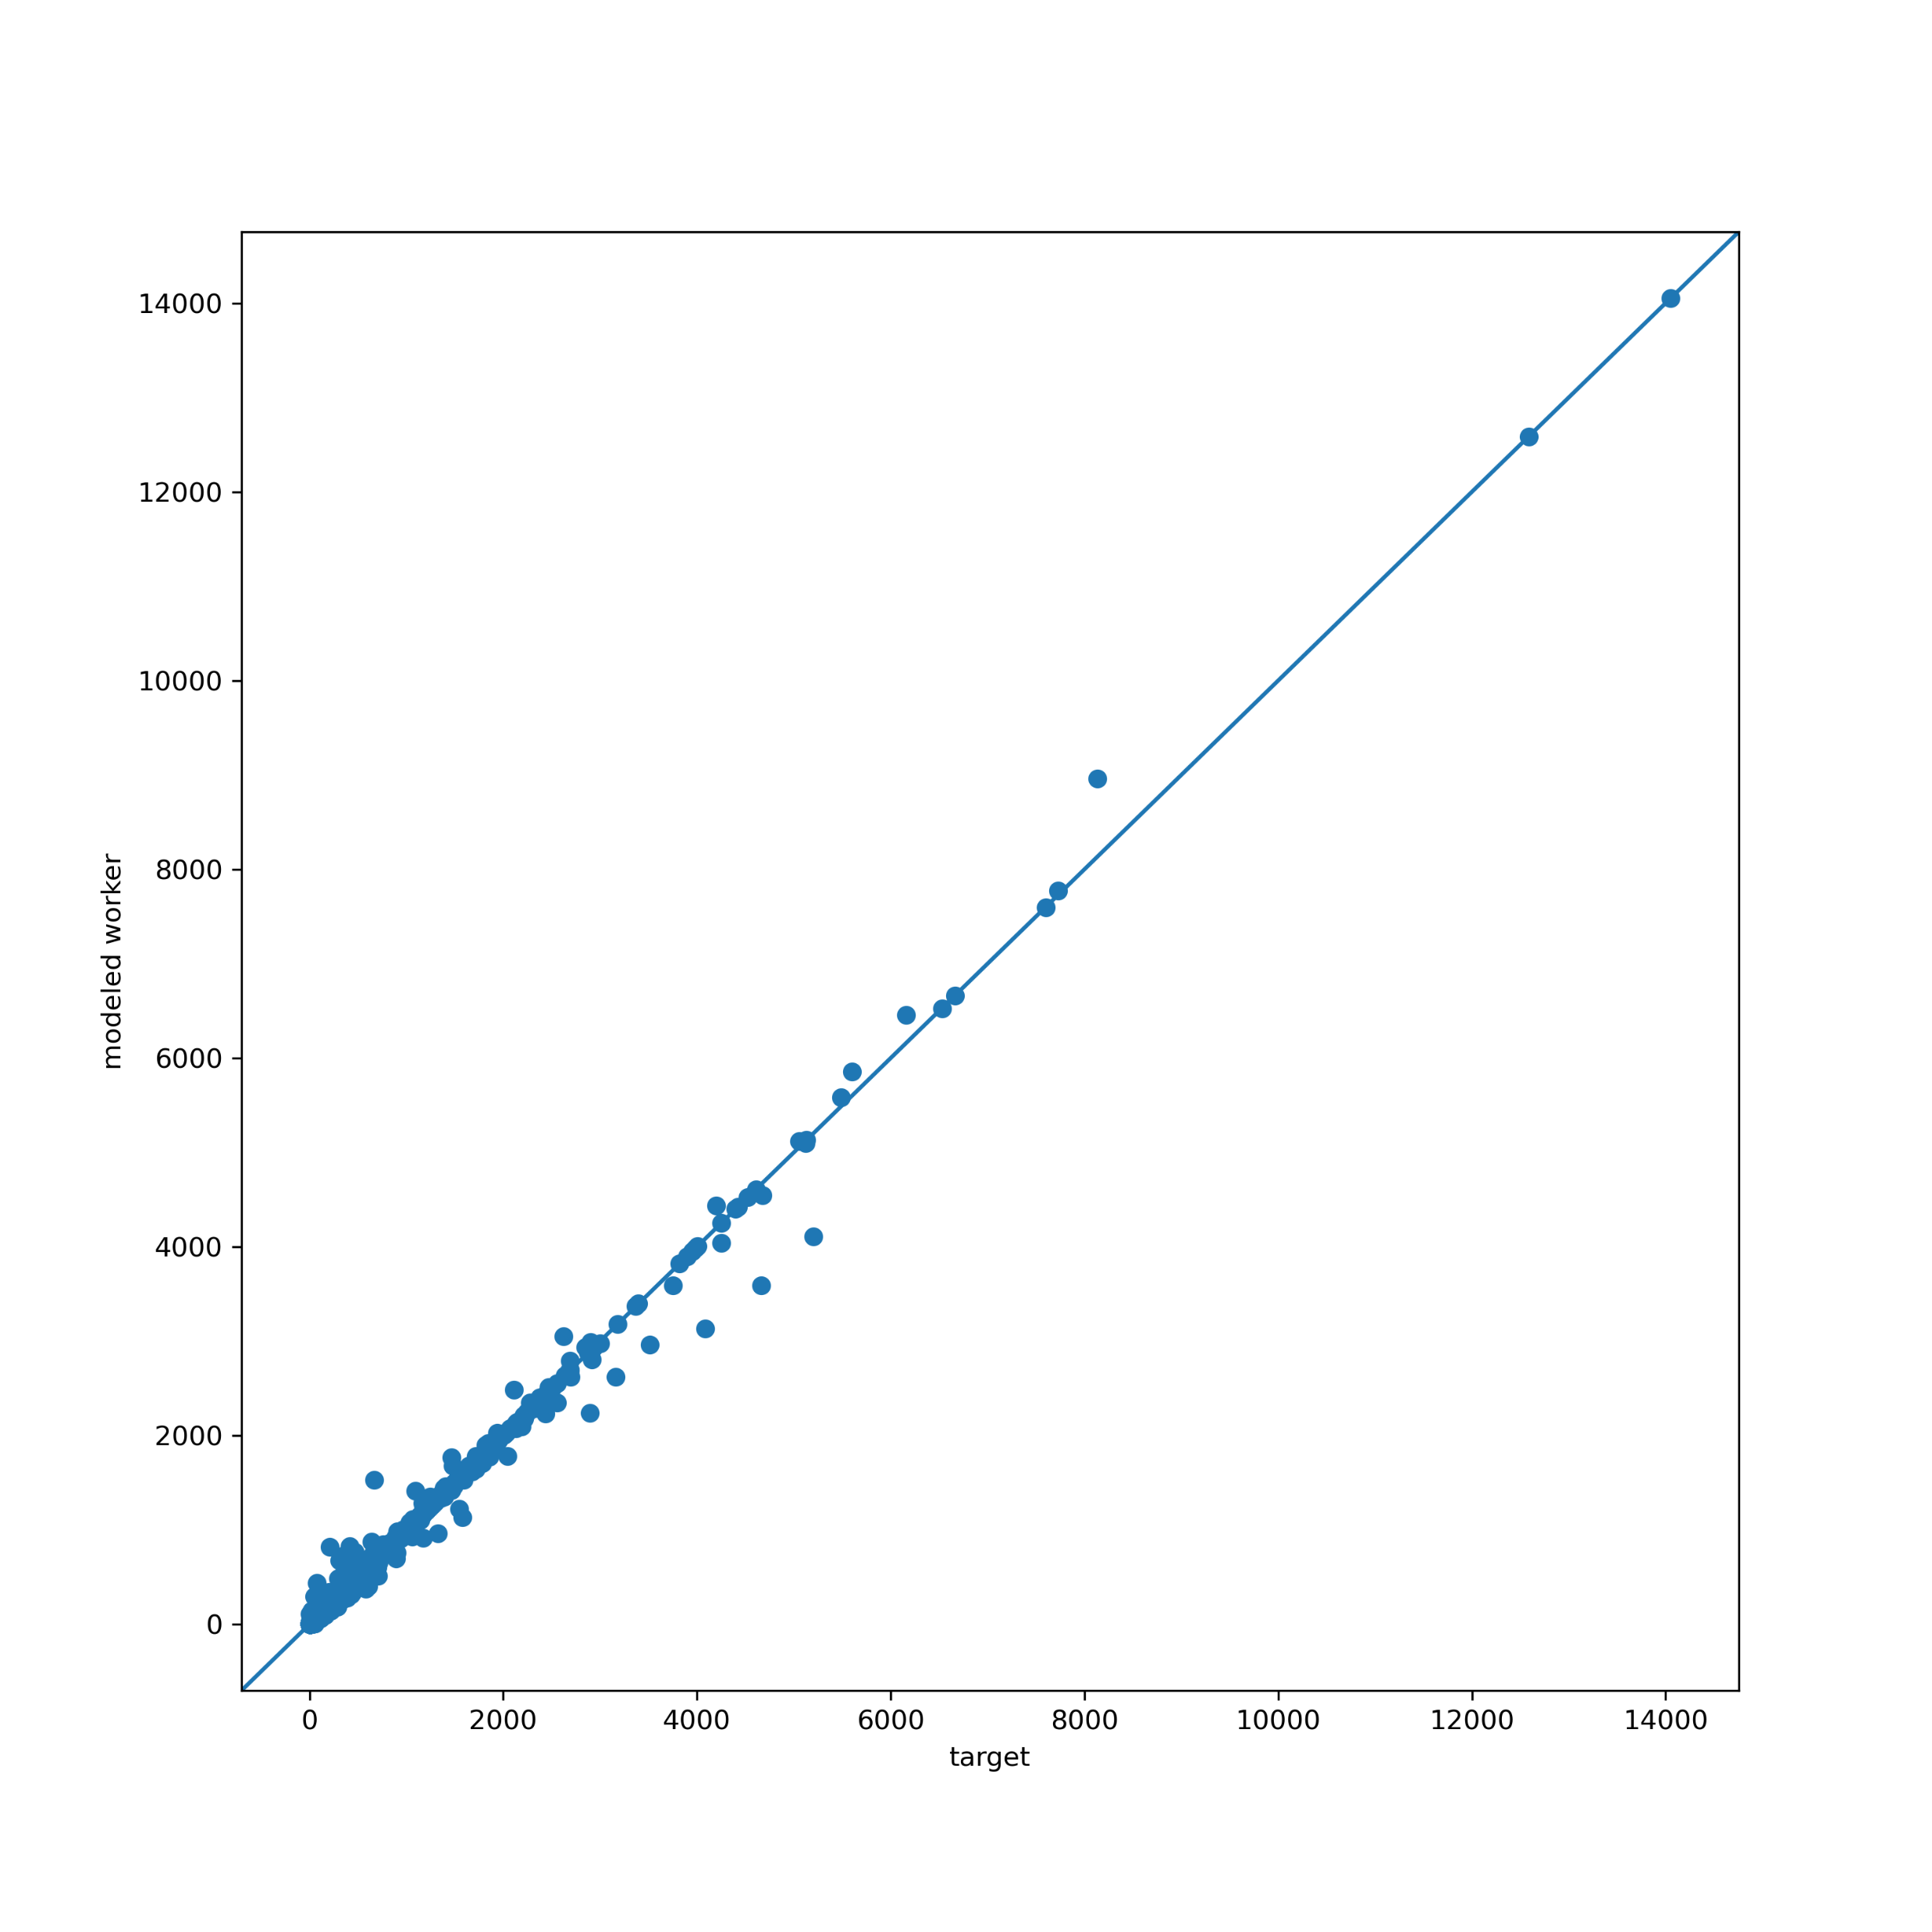
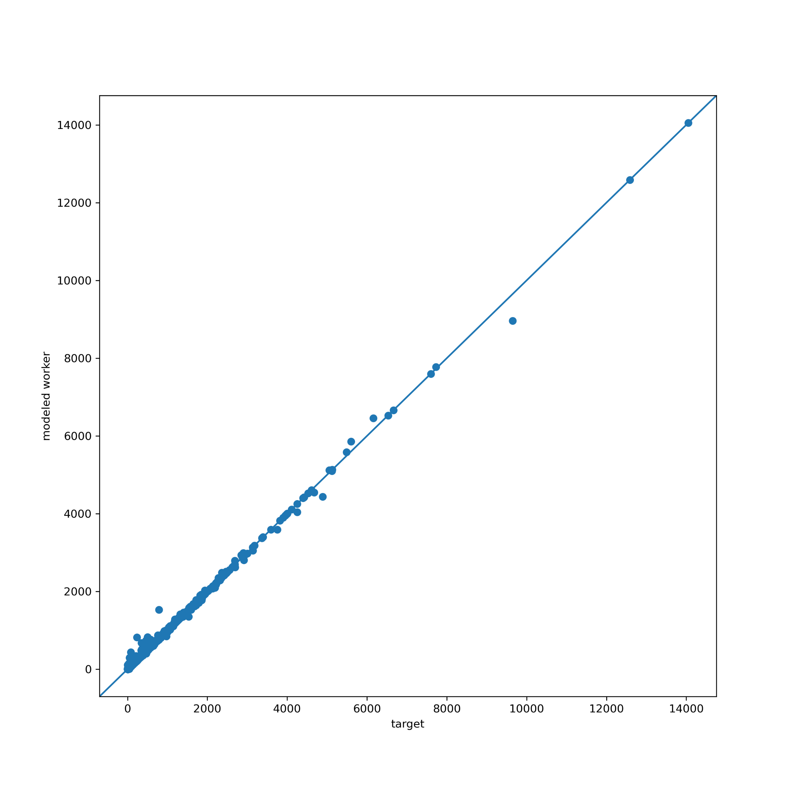
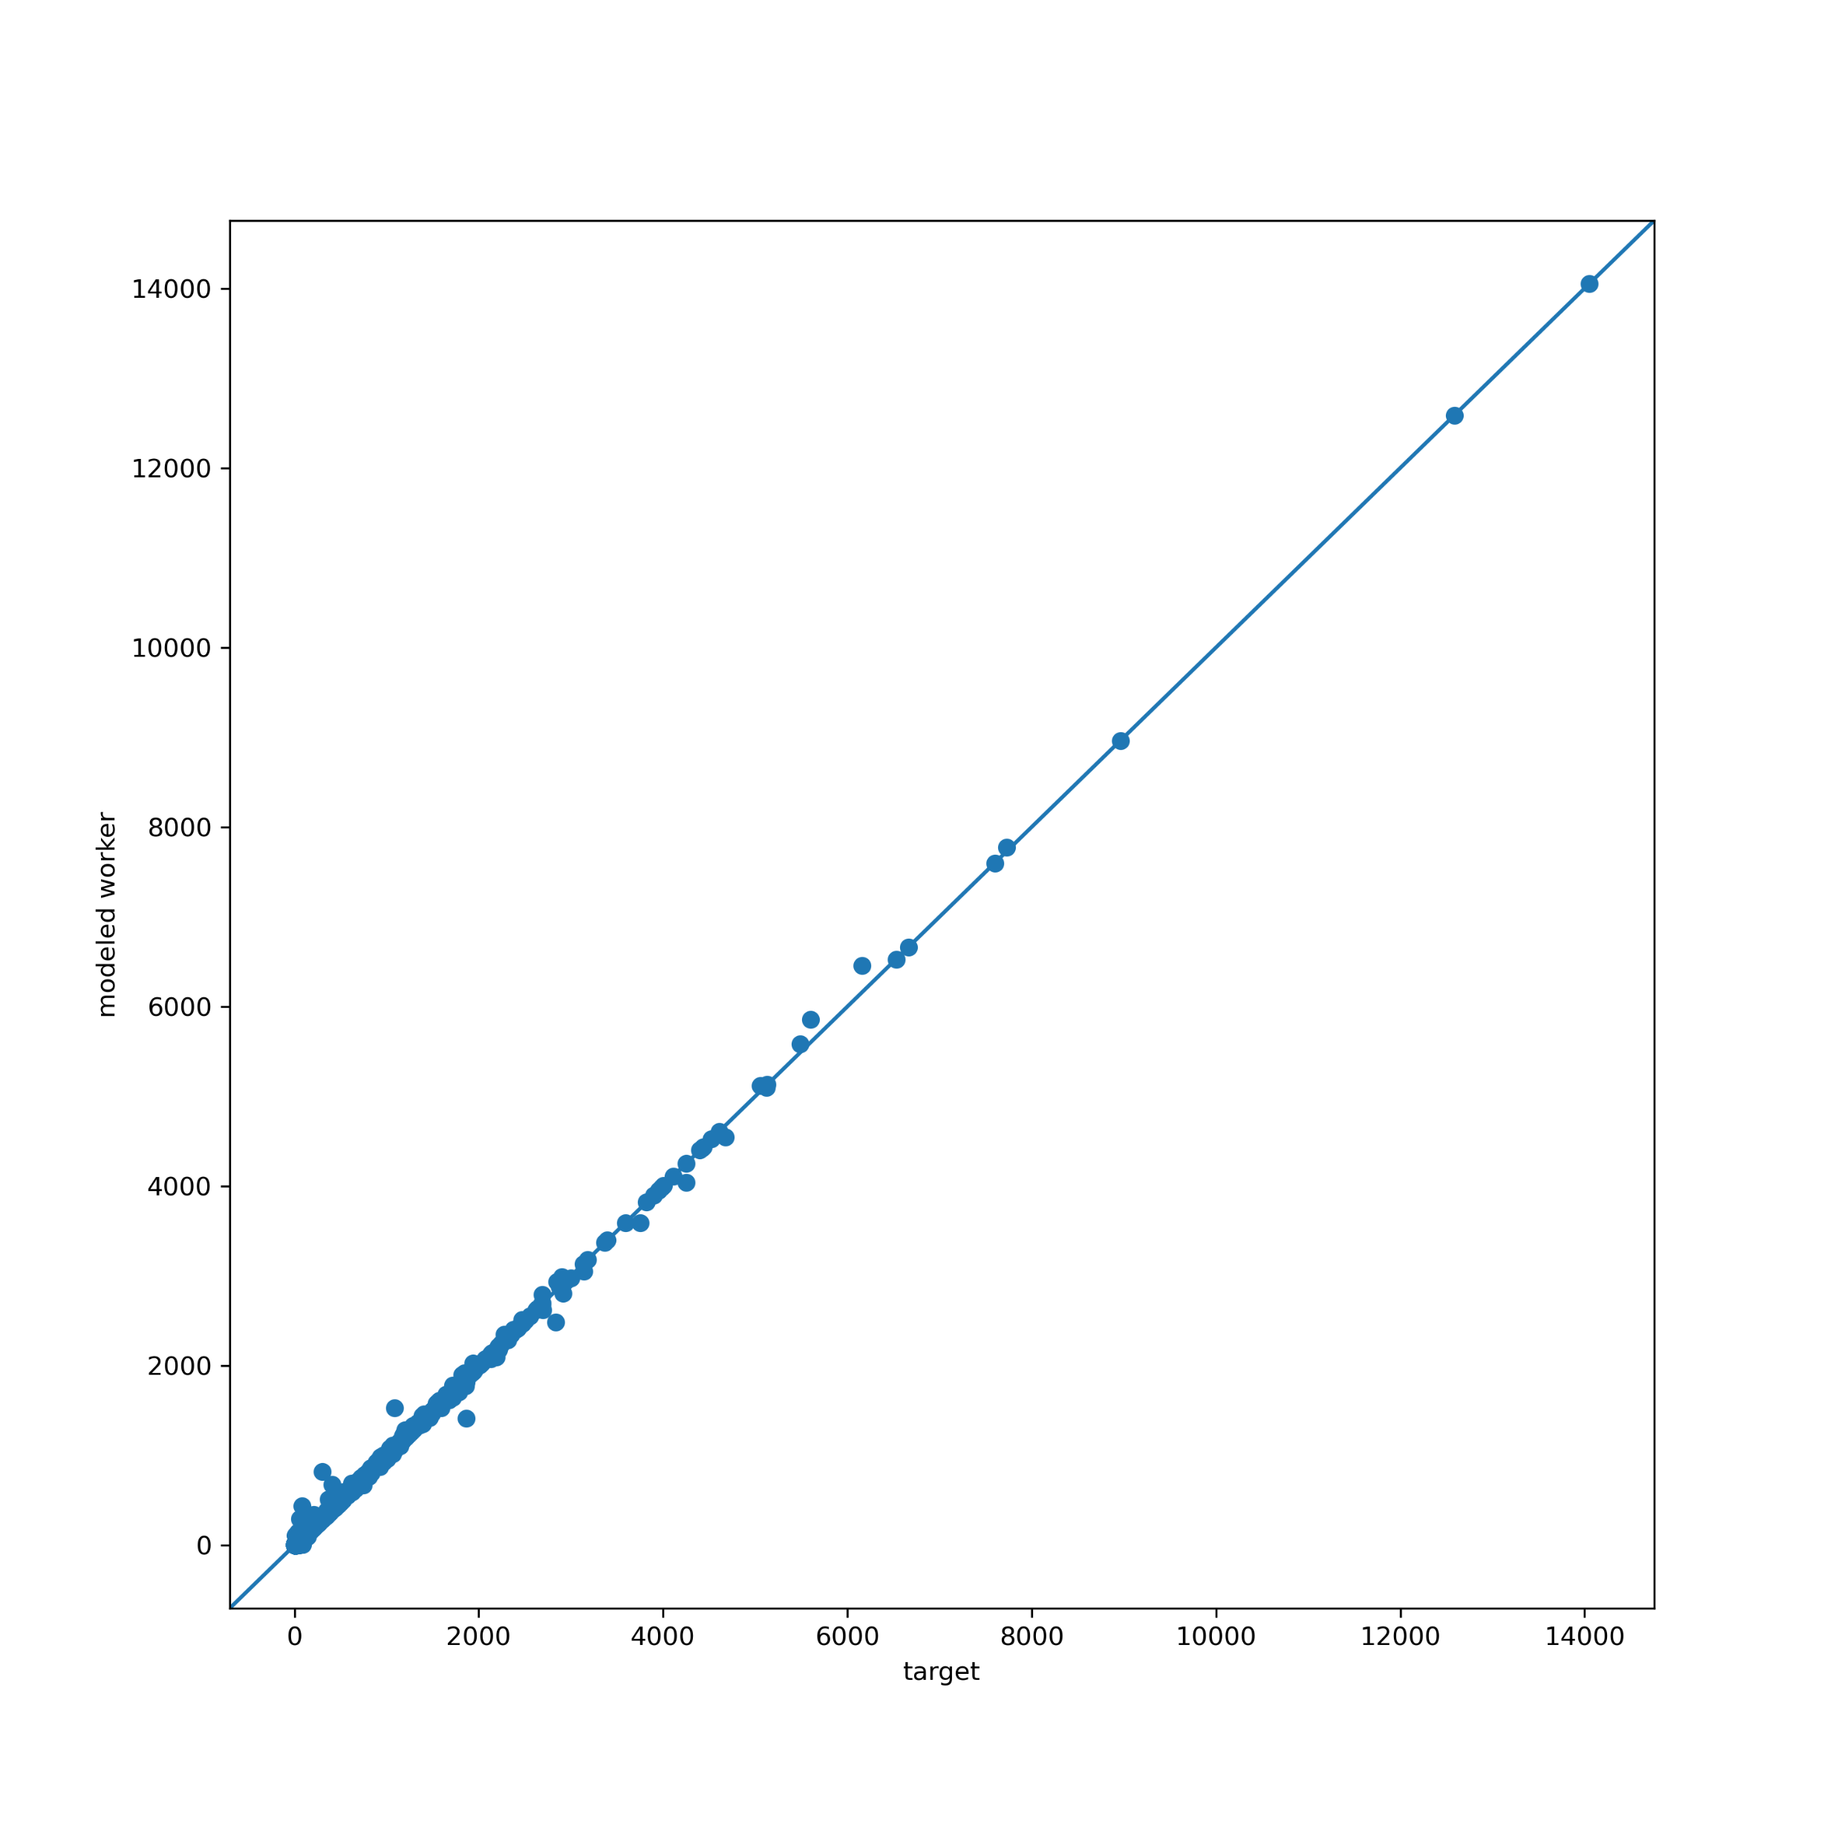
Testing: model worker vs. land-use employment
iter1
iter2
iter3
iter4
iter5
iter6
iter7
iter8

Slide 22
Testing: Run time
10 iteration run (Simulation-based method runs for 9 iterations as it converges)
16 intel cores
150 GB of RAM

Slide 23
Revised shadow pricing: average half-tour length change

Slide 24
Conclusion

Slide 25
Conclusion
Common location (destination) choice models are not capacity constrained by design.
Current model constraint mechanism are inefficient and time-consuming to run in real-world applications.
Our tests show the simulation-based approach not only runs significantly faster, but also converges faster than the legacy methods.
Method currently implemented for SEMCOG (Southeast Michigan) and SANDAG (San Diego) ActivitySim-based models.

Slide 26
Acknowledgement
This work was funded by the ActivitySim Consortium.
We would also like to thank the Consortium, SEMCOG, and SANDAG teams for their feedback in developing and implementing this approach.

Slide 27
Joel Freedman
Ali Etezady
David Hensle
Senior Director
Consultant
Consultant
Joel.Freedman@rsginc.com
Ali.Etezady@rsginc.com
David.Hensle@rsginc.com

